Slide 1



Prediction For Credit Card Approval

Slide 2


Exploratory Data Analysis
1
Dive into the Data
Conduct a comprehensive exploratory data analysis (EDA) on the dataset. Uncover valuable insights through data visualization, summary statistics, and pattern identification.
2
Understand the Factors
Perform Univariate and Bivariate analysis to understand the key factors influencing credit card approval decisions.
3
Reveal Business Insights
List down the business findings and insights gained from your EDA to guide the next steps in the project.

Slide 3
Feature Engineering
Create New Features
Transform Existing Features
Enhance Predictive Power
Leverage your domain knowledge and explore ways to create new features that can provide additional insights or improve model performance.
Experiment with transforming existing features, such as aggregating information or creating interaction terms, to uncover hidden patterns in the data.
Apply feature engineering techniques to enhance the predictive power of your machine learning models and drive better credit card approval predictions.

Slide 4

Data Preprocessing
Handle Missing Values
Encode Categorical Variables
Identify and address any missing values in the dataset, ensuring your models are trained on clean and complete data.
Transform categorical variables into a format that can be effectively utilized by your machine learning models.
Scale and Normalize Features
Prepare for Modeling
Apply appropriate scaling or normalization techniques to ensure your features are on a similar scale, improving model performance.
Ensure your data is ready for model training by completing all necessary preprocessing steps.

Slide 5
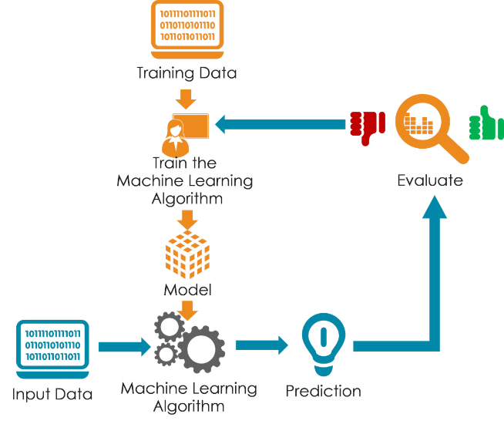
Model Development
1
Logistic Regression
Train a logistic regression model to predict credit card approval, leveraging its ability to handle binary classification problems.
2
Decision Trees
Experiment with decision tree-based models, which can capture complex relationships in the data and provide interpretable results.
3
Ensemble Methods
Explore ensemble techniques like random forests and boosting algorithms to combine the strengths of multiple models and improve predictive performance.

Slide 6


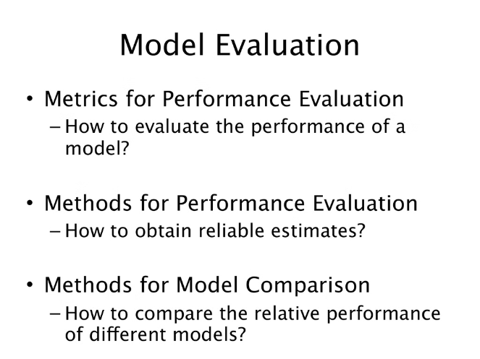



Model Evaluation
Accuracy
Assess the overall correctness of your model's predictions.
Precision
Evaluate the model's ability to correctly identify approved applications.
Recall
Measure the model's ability to identify all approved applications.
F1-Score
Combine precision and recall to get a balanced evaluation metric.

Slide 7





Predicting Approvals
Apply the Model
Use your best-performing model to predict the approval of credit cards in the test dataset.
Analyze Feature Importance
Understand the relative importance of each feature in driving the model's predictions, providing valuable insights.
Interpret the Results
Interpret the model's predictions and feature importance scores to gain a deeper understanding of the credit card approval process.

Slide 8
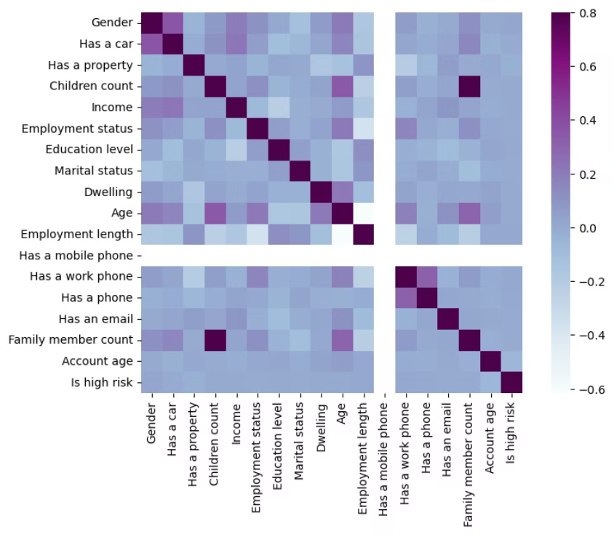
CORRELATION BETWEEN ALL THE NUMERICAL VARIABLES

Slide 9

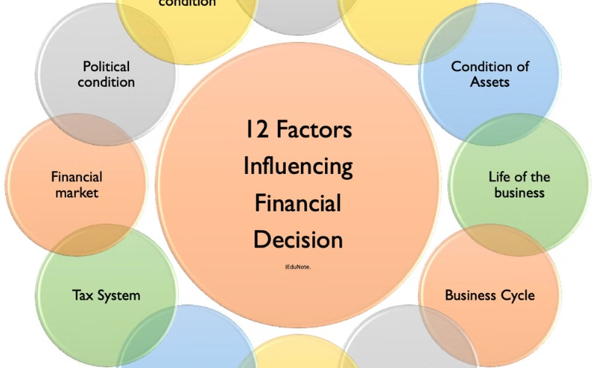
Recommendations
Actionable Insights
Driving Impact
Provide actionable recommendations to the business based on your findings, aiming to reduce risk and improve the credit card approval process.
Your recommendations should help the business make more informed decisions and enhance their credit card approval strategies, ultimately benefiting both the company and its customers.

